Slide 2
Presentation on Covid-19
PRESENTATION ON HOURLY EARNED WAGES

Slide 3
Introduction
A wage is that the distribution from associate degree leader of a security (expected come back or profits derived alone from others) paid to associate degree worker.
Wages area unit a part of the expenses that area unit concerned in running a business, and add price to the worker in honor of his principal protected note or internet investment.
Payment by wage contrasts with salaried work with commission that conditions pay on individual performance.

Slide 4
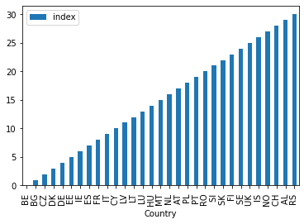
Name of the countries from where data has been collected
There are 32 countries where data has been collected.

Slide 5
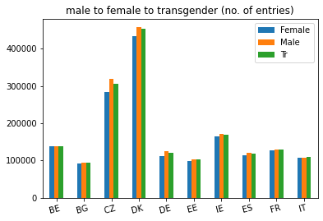
Male to Female to Transgender Ratio:
Almost in every country, the Male;s hourly working wages is higher as compaired to female or transgenders.

Slide 6
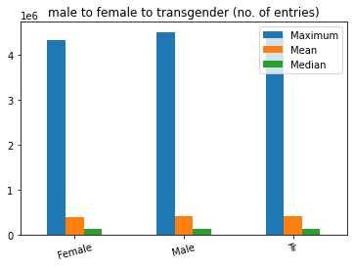
Max Mean Median
This graph shows the cumulative max, mean and median of all entries arranged by their gender.

Slide 7
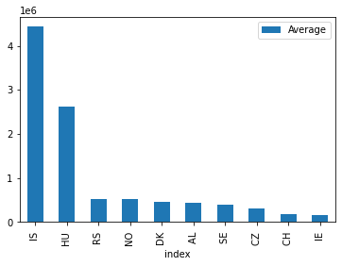
Top 10 Country’s Average Income
Here’s a bar graph view of top 10 countries with max average hourly wages where IS tops with 443200 followed by HU, RS and NO respectively.

Slide 8
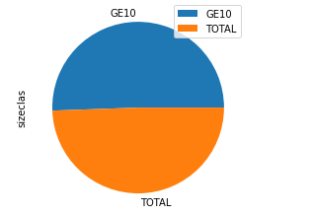
Types of Sizeclas
Based on our research, there are 2 different sizeclas namely GE10 and TOTAL consisting of 49.6% and 50.4% respectively.

Slide 9
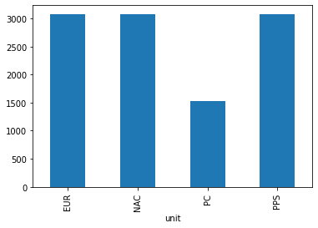
Different Units of Currencies.
Commonly the hourly wages are paid in 4 different types of currencies where EUR, NAC, PPS are used to pay commonly while PC is preferred a little less.

Slide 10
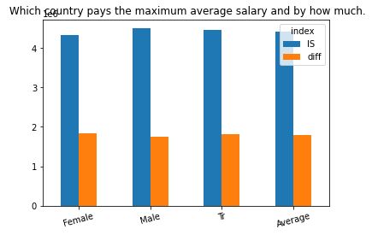
Country with Maximum hourly wages.
Country IS pays their hourly waged workers the most, with a quiet much more than what HU pays.

Slide 11
Conclusion
PROS:
Helps completing small works with less pay.
People can earn more as part time.
Resolve financial issues.
In Europe, every country has similar hourly wages for each gender. Hourly wages of male is way more than female and transgenders. Also, Argentina has maximum hourly wages, and IS has the maximum average wage.
Cons:
Hardworking.

Slide 12
References
https://www.thebalancecareers.com/hourly-vs-salary-employees-2063373
https://data.europa.eu/euodp/en/data
https://en.wikipedia.org/wiki/Wage

